Slide 1
Decorator Pattern
By
Narendran, S S

Slide 2
Key Items
IS A and HAS A Relationship
Recursive Wrapping
Has “Indirection by Default” behavior.
Power of Extension at runtime with Composition
“Favor Composition over Inheritance” & “Open for Extension, Closed for Modification”
Class Explosion with Inheritance. Inheritance is static to add behavior.
Partial “Is a” Relationship Achieved with “Has a” Relationship by Constructor Injection – Extend at Runtime instead of Compile time.
Overriding by Contract and access of properties & public methods by Object Inspection.
Effective Change Management, yet Changes are always prone to error.

Slide 3

Decorator Pattern
The decorator pattern is a design pattern that allows behavior to be added to an individual object, either statically or dynamically, without affecting the behavior of other objects from the same class.

Slide 4
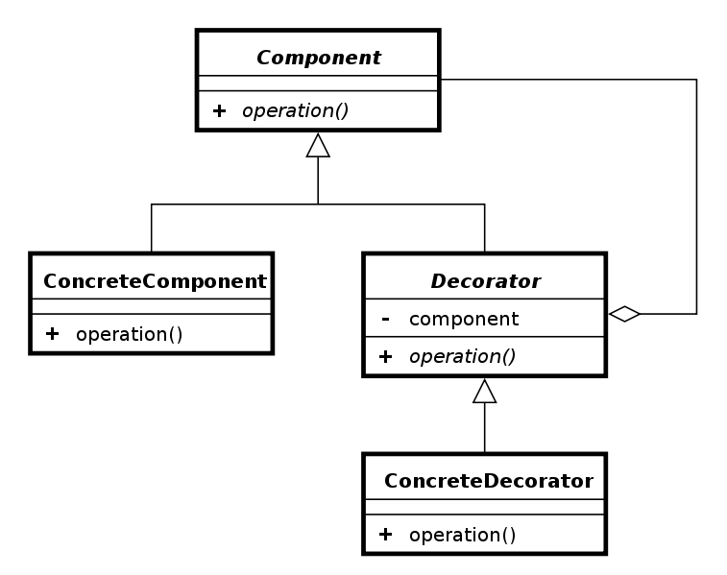
Decorator Pattern - UML

Slide 5
Pros and Cons
Pros
Lot no. of Class Creation can be avoided.
Helpful when one base Class need to be customized with various customization.
Cons
Instead of Class Explosion, Object Explosion can happen.
Object Creation becomes Indirection by Default and is prone to error.

Slide 6
References
http://javapapers.com/design-patterns/decorator-pattern/
http://oreilly.com/catalog/hfdesignpat/chapter/ch03.pdf
http://sourcemaking.com/design_patterns/decorator

